Slide 1

COM-711 Selected topics IN Computer vision 2d tracking part 2/2
kevin.smith@lmc.biol.ethz.ch
Kevin Smith
Notes:
Good morning… welcome to
Part 2/2

Slide 2
Course update
Lectures
week
1
2
3
4
5
6
7
8
9
10
11
12
13
14
Student
Presentations
Image Denoising
Vincent Lepetit
2D Tracking
Kevin Smith
Data Clustering
Mario Christoudias
Segmentation
Fethallah Benmansour
Inference on Graphical Models
Yunpeng Li
Notes:
No class on Week 14

Slide 3
Course update
Final mark
50% homework
50% presentation
Homework mark
Considers only the best(N-2) scores from N total assignments
Final Mark
50% Homework
HW1
50%
Oral Presentation
HW4
HW5
HW2
HW3
HW6
HW7

Slide 4
Oral presentations
Each student will present a published paper on topics covered in the course to the rest of the class
Each student has approx 20 minutes to speak (including questions)
A list of papers you may select from will be posted on the web site http://cvlab.epfl.ch/teaching/topics/index.php
Alternatively, you may propose a paper to present (subject to approval)
Instructors and other students will ask questions about the work
Presentations will be held during on Nov 18, Nov 25, Dec 2, Dec 9, Dec 16. Time slots will be assigned on a first-come-first serve basis, after the list is posted. A web site will be made available to sign up with your selected paper and time slot

Slide 5
Course update
Homework: 7 total assignments
Only the best N-2 scores from N total assignments will be considered (you can “skip” two assignments)
First 4 assignments available on course web site http://cvlab.epfl.ch/teaching/topics/index.php
Image denoising
Segmentation
2D Tracking
Inference on Graphical
Models
Data
Clustering
Notes:
7 assignments – this number is not set in stone.
First 4 (5) assignments are posted on the web site.

Slide 6
Outline
Introduction to the tracking problem
Recursive Bayesian filtering
What is tracking?
Background & formulation
Kalman filter
Particle filter
Approaches , assumptions, &applications
State of the art & challenges
Notes:
I will quickly review a bit of what we went over last week

Slide 7
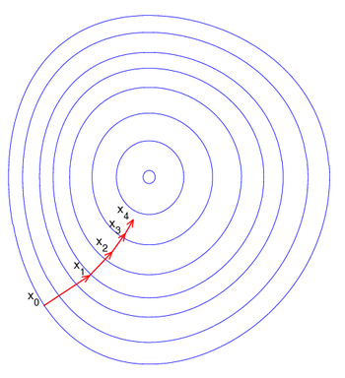
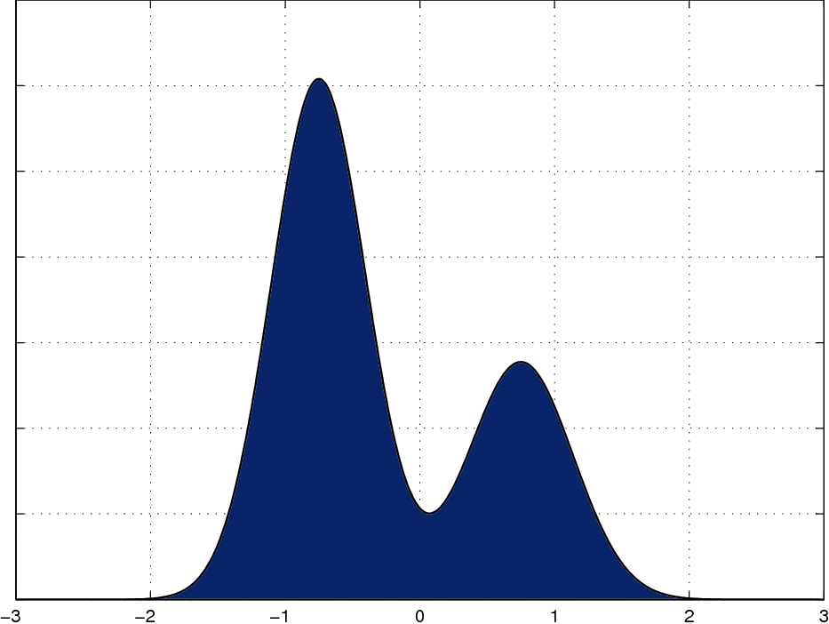
Recap: approaches to tracking
Non-probabilistic
+ quick convergence*
+ efficient
- stuck in local max/min
- modeling multiple objects
Probabilistic
+ flexible, principled
+ multi-modal
- slower
- interpretation
Notes:
There are 2 general approaches to inference
Non-probabilistic optimization techniques:
-mean shift
-gradient descent
-least squares,
-Graph based techniques (K shortest paths, Dijkstra’s algorithm)
-AI (agents)
1.quick to converge
2.Efficient
3.But they can get stuck in local minima/maxima
4.They also are not formulated well for modeling multiple objects
5.** Can be difficult to incorporate a motion model into such frameworks **
Probabilistic techniques:
1.Very flexible – allows you to model motion and appearance however you like
2.Principled – grounded in probability theory
3.Multi-modal – can easily model uncertainty in belief with multiple mode
4.Often-time can be slower
5.Probabilities must be interpreted in order to obtain a final *result*

Slide 8

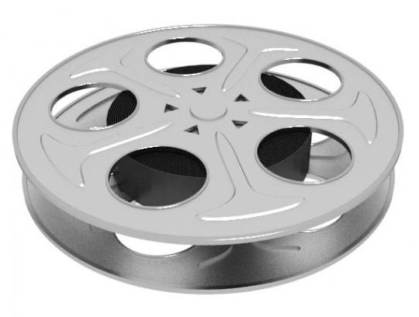
Recap: approaches to tracking
Sequential
(recursive, online)
+ Inexpensive → real-time
- no future information
- cannot revisit past errors
Batch Processing
(offline)
- Expensive → not real-time*
+ considers all information
+ can correct past errors
t=1,…,T
t-1
t
t+1
Notes:
There are many ways to group/categorize tracking methods, we’ll look at a few.
+Sequential (recursive, online):
*Think of it like a film strip: moving from one frame to the next
Recursive – your estimation of an objects state depends on your previous estimations of object state
Online – can be performed while data is incoming (ie can be real-time)
Drawback – cannot consider future information (it has not arrived yet)
Drawback – an error can affect subsequent estimations
Batch (offline)
*Think of it like looking at the entire reel of film at once
You estimate the state for the entire sequence at once, considering all the data. This allows you to go back and correct past mistakes in light of new information.
In many applications (surveillance, robot navigation, assisted driving) – real time performance is IMPORTANT.

Slide 9
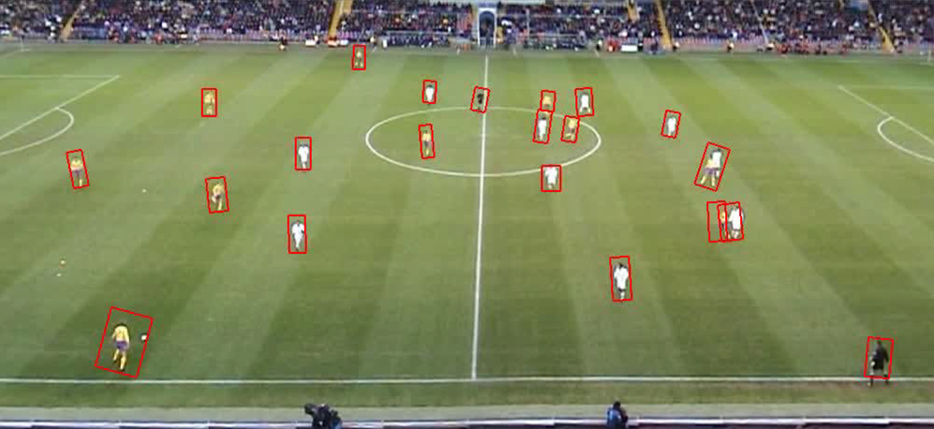
Recap: approaches to tracking
Parallel trackers
several single-object trackers
computationally less expensive
ad-hoc interaction
Joint state
single multi-object representation
computationally expensive
explicit principled interaction
Notes:
Another way to categorize tracking approaches is how they handle multiple objects
Having many objects in the scene can be confusing.
How do you:
*model multiple object paths
*associate data (object detections) to the correct path?
2 general approaches:
Parallel trackers
@click (cross-over is a difficult problem for trackers!)
Joint state trackers

Slide 10
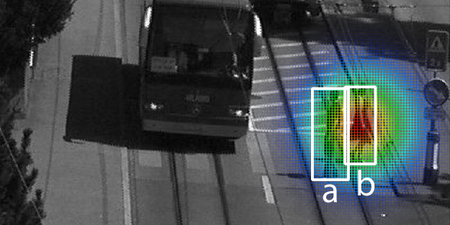
Recap: recursive Bayesian filtering
Probabilistic Formulation
Sequential
Multiple Objects
Notes:
Recall that we introduced the recursive Bayesian filtering approach to tracking – one of the most widely used approaches
Probabilistic
– our belief as to the state of the system, the dynamic process, and the observation model are represented as PDFs
Sequential
– each time step we only look at the estimate from the previous time step, and the data from the current time step
Multiple objects
– depending on how you define the state, you can track one or many objects

Slide 11
Recap: recursive Bayesian filtering
Filtering equation
Definitions
State from 1 to time t:
Observations from 1 to time t:
posterior
estimate
likelihood or
observation model
motion model or
dynamic model
posterior
estimated at t-1
Notes:
Here is the fundamental filtering equation. Notice that it has the components we’ve already seen: LIKELIHOOD (observation model) and MOTION MODEL (dynamic model, state evolution)
What is the posterior? It is what we are trying to find. It asks the question: What is the probability of the state x_t given the current and past observations Z_t?
Equation says that the probability of the CURRENT STATE given all previous OBSERVATIONS is determined by
1.a prediction made by the MOTION MODEL based on the PREVIOUS STATE, that has been
2. corrected by the LIKELIHOOD term (the OBSERVERATION MODELs response to an image measurement)
Remind ourselves of the definitions: State is x_t, observation is z_t

Slide 12
Recap: recursive Bayesian filtering
Key idea 1. PDFs represent our belief as to the state of the object
Key idea 2: Recursive cycle
Predict from motion model
Measurement from image
Correct the prediction
…repeat
predict
measure
correct
Notes:
I want to give you an INTUITION as to how recursive Bayesian filtering works, and introduce the TWO KEY IDEAS
*(click) trajectory appears
Green arrow the TRUE PATH of the object over time
Blue X’s -> locations of object at sampled time instants
KEY IDEA 1
*Click & show Gaussian
KEY IDEA 2
*1. Click predict
*2. Click measure from the image
*3. Click correct the prediction using information from the measurement
*Now, we RECURSE by using ESTIMATE 2 to drive a prediction for ESTIMATE 3

Slide 13
Recap: recursive Bayesian filtering
State definition Represent the object
Observation model Take measurements from the image
Dynamic model Predict the next state given current state
predict
measure
Inference method Solution estimation
correct
Notes:
So what MODELS (INGREDIENTS) do we need in order to do Recursive Bayesian Filtering?
1.State definition -> a mathematical representation of the properties of the object
2.Dynamic model -> predicts values for the next state given the hypothesis of the current state
3.Observation model -> measures like likelihood of the state (location, pose, etc) of the object within the image
4.Inference method -> our method for estimating the tracking solution

Slide 14

Recap: state definition
State vector x_{t} describes object(s) at an instant in time
Defines solution space
x₃
x₄
x₂
x₅
x₁
x₆
Notes:
State is a mathematical description (PARAMETERIZATION) of the object
State for a given time step (t) is defined as x_t
State for the entire sequence up to time (t) is X_t
*(Click) state can contain ONE OBJECT or MANY OBJECTs at each time step

Slide 15
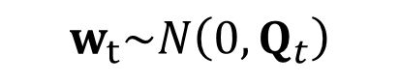
Recap: dynamic model
Predicts new state x_{t} based on previous state x_{t-1}
Often a linear transform + Gaussian noise
Predicted state
time t
Gaussian noise
$$w_{t}\sim N\left({0,Q}_{t}\right)$$
State transition model
Previous state
time t-1
Notes:
Most systems use some kind of Linear Dynamic model
x_t is the predicted state at time t
x_{t-1} is the previous state
F is the state transition model
w_t is the noise term, usually sampled from a Gaussian
Common model types include:
1st order autoregressive
-Linear transformation & Gaussian noise term.
-state depends on previous state including the 1st order derivative (velocity)
2nd order autoregressive
-state depends on previous state including the 1st + 2nd order derivatives (v + acceleration)

Slide 16
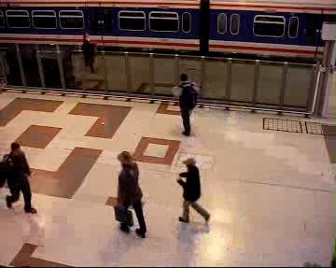
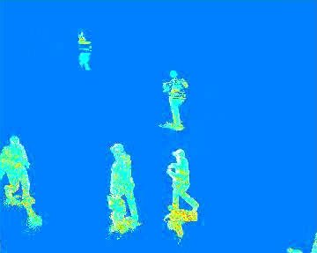
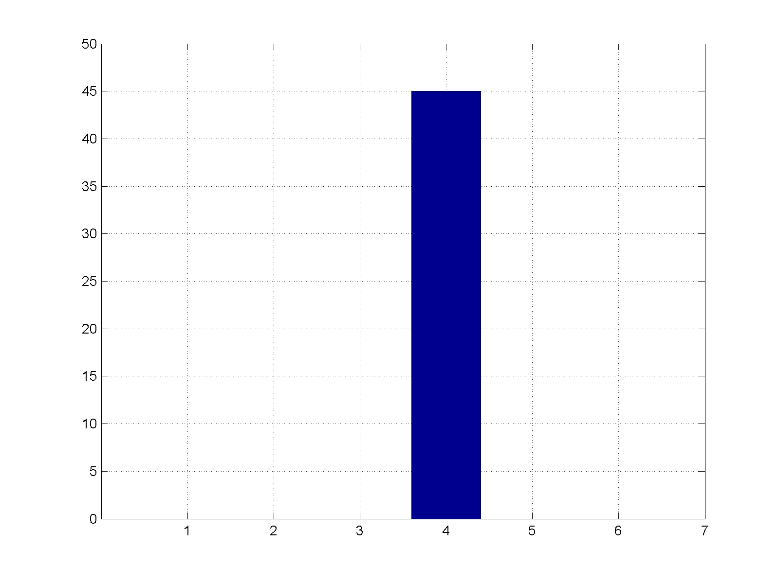
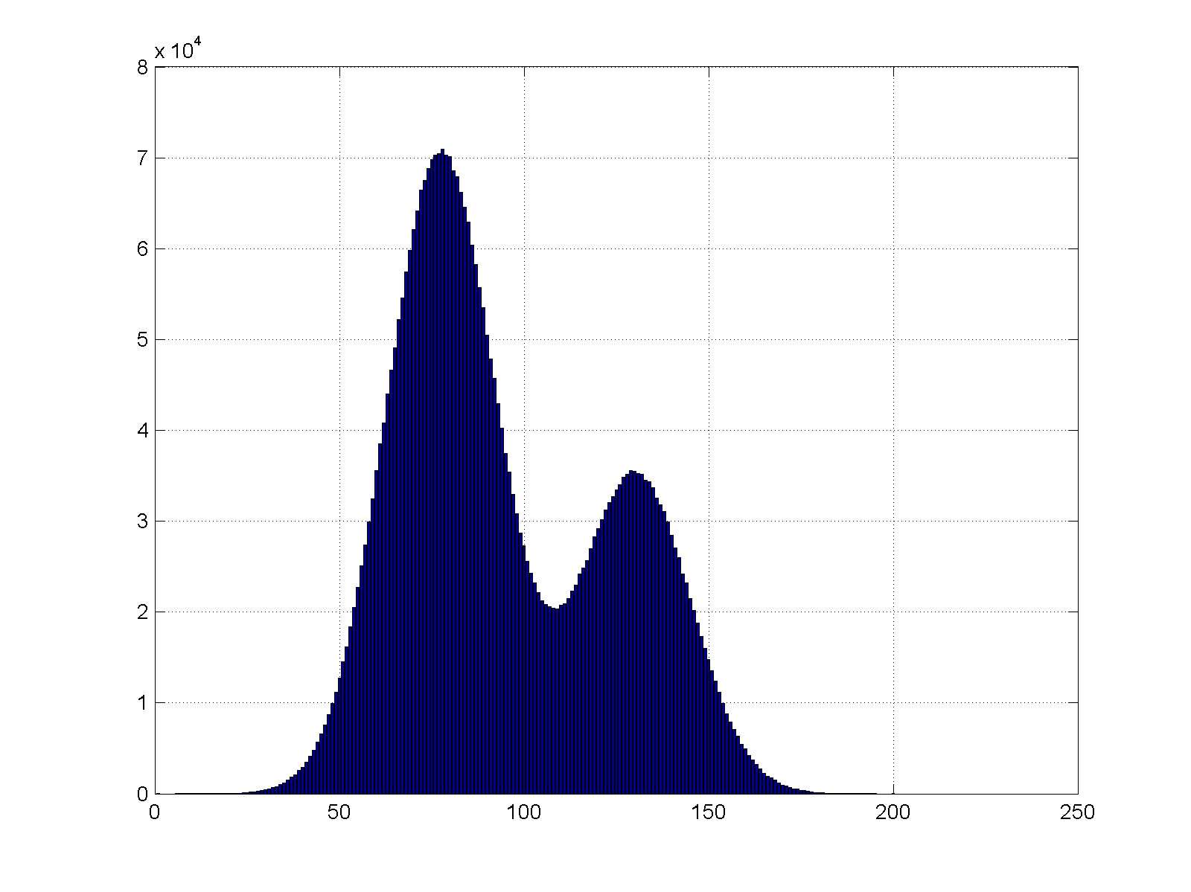
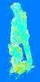
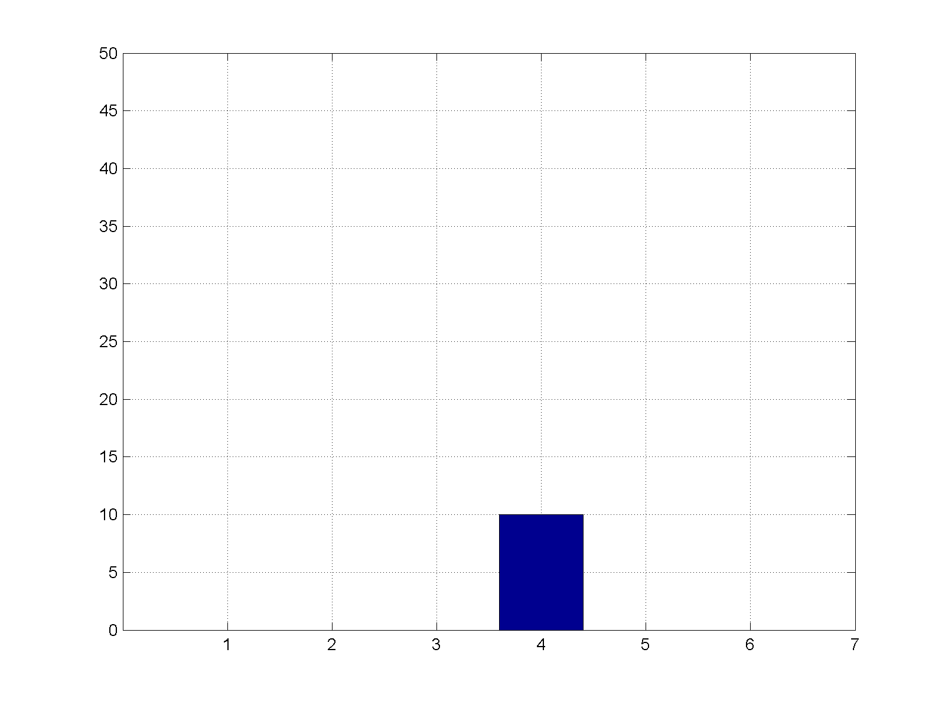

Recap: observation model
Models the likelihood that a state estimate x_{t} gave rise to the observed image data z_{t}
x_{t}
I
z_{t}
Notes:
Measurement is our noisy observation that results from the underlying state!
models the likelihood that state estimate gave rise to the observed image
@ if we make a good estimate with the blue bounding box
@ we extract some measurements from the image based on that state estimate
@ our observation model turns that measurement into a probability expressing whether or not the data supports the hypothesis – i.e. does the image data agree that there is a person here? Here we might build a model that says “if there is a large vertically shaped foreground blob, there is probably a person here”. This would give a high likelihood response – thus REWARDING the good estimate
@ on the other hand, if we make a bad estimate…
@ these were all discrete examples, we took a specific hypothesis and made an evaluation for that hypothesis. But if we were do it in a continuous space, we get something more like this.

Slide 17
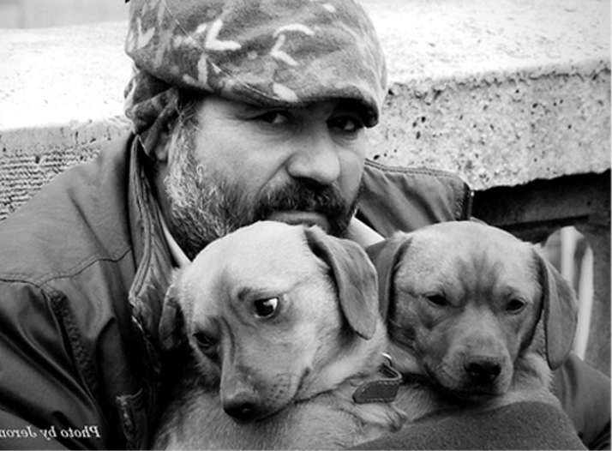
Probability distribution to model belief in object location
Tracking faces in frame t
Notes:
Now we looked at a probabilistic inference method, and all of the models necessary for tracking (state model, dynamic model, observation model).
IN PRACTICE, how can probability distributions be used to represent our belief about the state of the system?
As an example, let’s say we are tracking faces in a video. This image is frame t. We want to model our belief about the where a face lies in the image.

Slide 18
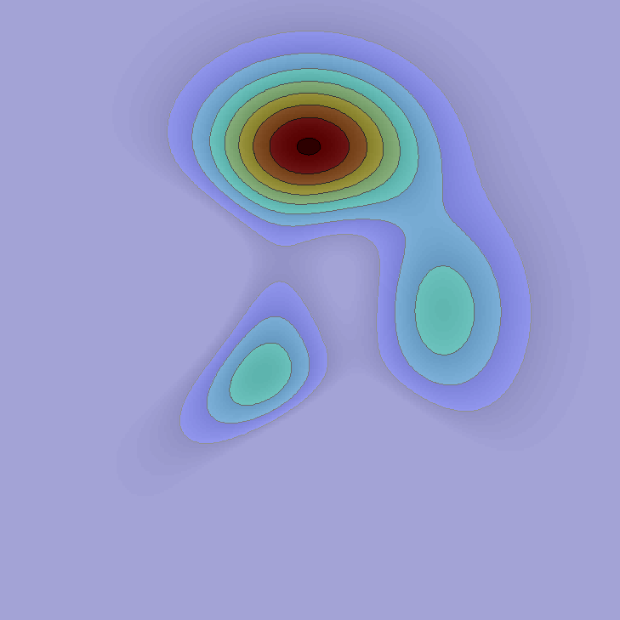
Probability distribution to model belief in object location
Posterior or target distribution – models belief as to the state of the system given the observations up to t
Peak 1
Peak 2
Peak 3
Notes:
Note here that you can see that it is MULTI-MODAL, meaning we have several distinct peaks.

Slide 19
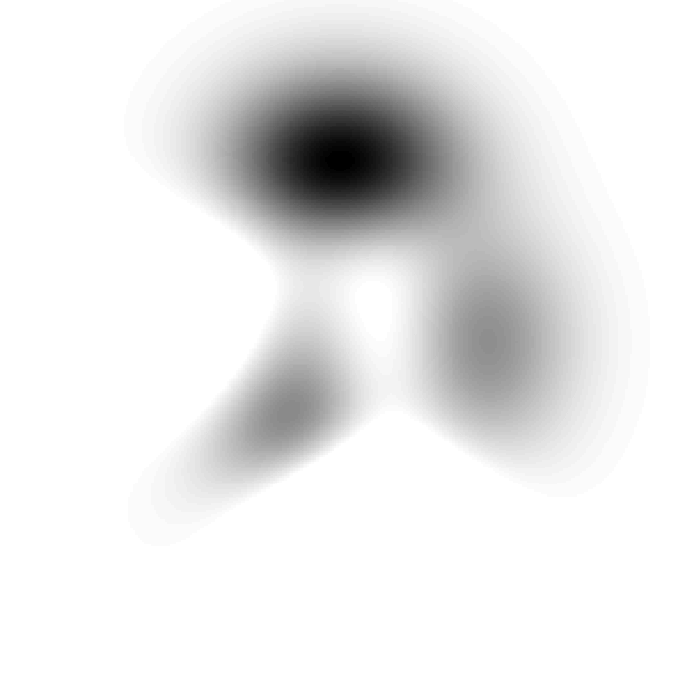
Representing the posterior
A point (dirac)
Notes:
The simplest way of representing the distribution is as a point, or a DIRAC FUNCTION. It takes a value of 1 at the center location and zero else where.
This is too simple.

Slide 20
Representing the posterior
Gaussian
Notes:
A Gaussian distribution is a convenient tool for modeling probabilities because we can perform many operations with it.
A Gaussian distribution is centered at mean MU, and it’s width is defined by the covariance SIGMA
When we use the recursive Bayesian filtering distribution for
1.a continuous state-space,
2.linear dynamics,
3.and Gaussian likelihood density,
What do we get? A Kalman Filter (optimal solution to the tracking problem)

Slide 21
Representing the posterior
Mixture of Gaussians
Notes:
However, this still isn’t a perfect representation of the posterior distribution (our belief of the system state).
We can combine several Gaussians in a Mixture of Gaussian framework. Several gaussians with their own means and widths. Each gaussian is weighted.
This is an improvement because it can represent multi-modal distributions

Slide 22
Representing the posterior
Set of discrete samples (particles)
Notes:
Most interesting/practical OBSERVATION MODELS do not provide a Gaussian as an output.
Unfortunately, in these cases, directly computing the posterior is intractable. So, what can we do?
One option is to represent the distribution by a set of uniformly weighted samples. Even if the observation model is non-gaussian, it can always be sampled at different locations in the image.
Here the density of the samples corresponds to the probability density.
POINT OUT EQUATIONS!

Slide 23
Representing the posterior
Set of weighted samples (particles)
Notes:
If we assign WEIGHTS to the samples, our model becomes more sophisticated. Now the probability density at a location takes into account the weight and density of nearby samples.
Using this approach, we need less samples to represent the posterior.
Each sample is defined by a state hypothesis & weight pair.
1.Weights range from 0 to 1
2.Weights are normalized to sum to 1.
POINT OUT EQUATIONS!
This is how PARTICLE FILTERS represent the posterior of the Bayesian filtering distribution.
Let’s see an example of how different ways of representing probability distributions are used in practice…

Slide 24

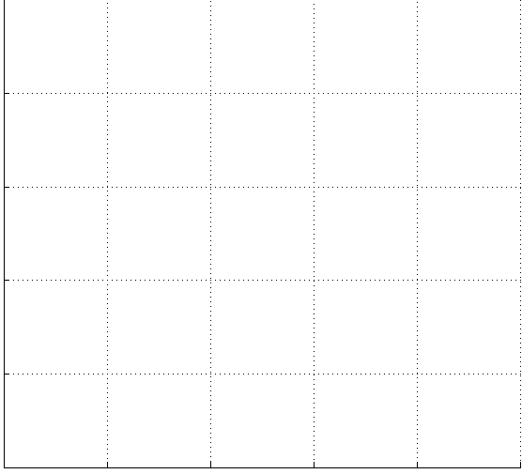
Recursive Bayesian filtering
24
Models belief about the current state given past and present observed data .
Kalman filter
exact solution
[1] Kalman, R.E. A new approach to linear filtering and prediction problems. ASME, Journal of Basic Engineering, 1960.
proposal
seed
seed
proposal
SIR particle filter
discrete approximation
[2] M. Isard and A. Blake. Condensation, International Journal of Computer Vision, 1998.
y
proposal
acceptance test
acceptance test
acceptance test
MCMC particle filter
discrete approximation
[3] Z. Khan, T. Balch, and F. Dellaert, An MCMC-based particle filter for tracking multiple interacting targets, ECCV, 2004.
x
Notes:
3 incarnations of recursive Bayesian filtering
Kalman filter (exact solution)
1.X represents the true location of the object we want to track & the blue blob is a Gaussian representing our belief about where the object is
2.(click) The object moves up in the next time step
3.(click) The Kalman filter’s dynamic model will predict a new location of the object based on its previous state
4.(click) After making a measurement, we will correct our prediction . We now have a new estimate of the state of X
PARTICLE FILTER (discrete approximation)
SIR – Sequential importance resampling
1.This time, X moves to the upper left
2.Our belief about the previous time step is represented by a set of weighted particles
3.Resampling -> resample the previous set of particles according to their weights. Some will disappear, some will spawn new particles! Re-assign all weights to be equal.
4.Prediction -> propagate each particle independently according to the dynamic model
5.Update -> set the weights of each particle according to observation for the predicted state
-The new set of weighted particles represents of our belief at time t+1
MCMC particle filter
MARKOV CHAIN MONTE CARLO
1.Sample a SEED particle and propagate it according to the dynamic model
2.Sample another particle, propagate it according to the dynamic model
3.Perform an ACCEPTANCE TEST between the SEED and PROPOSAL by comparing the likelihoods of each
4.If the proposal is better than the seed, keep it. Otherwise, keep the proposal with probability proportional to the likelhood ratio

Slide 25
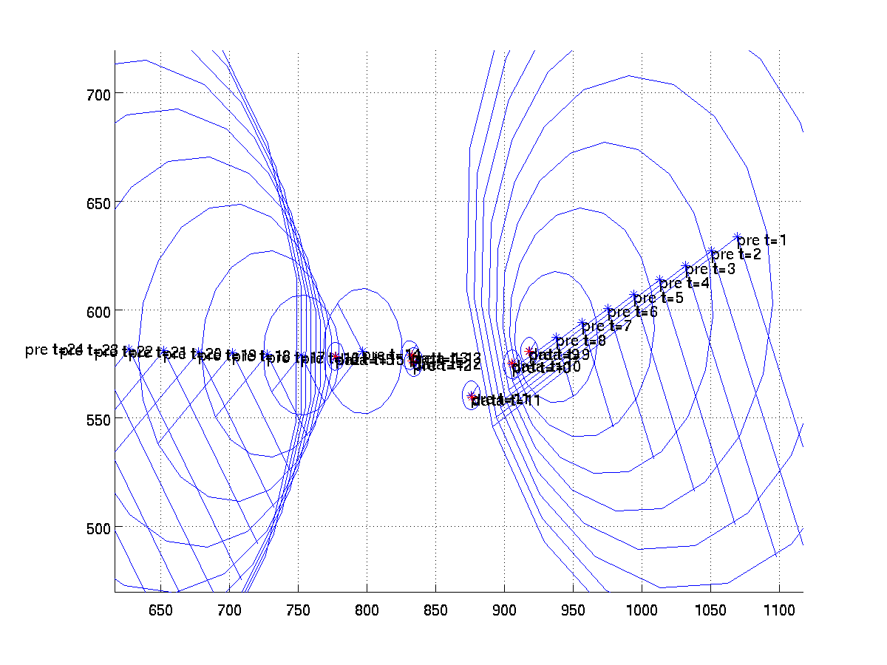
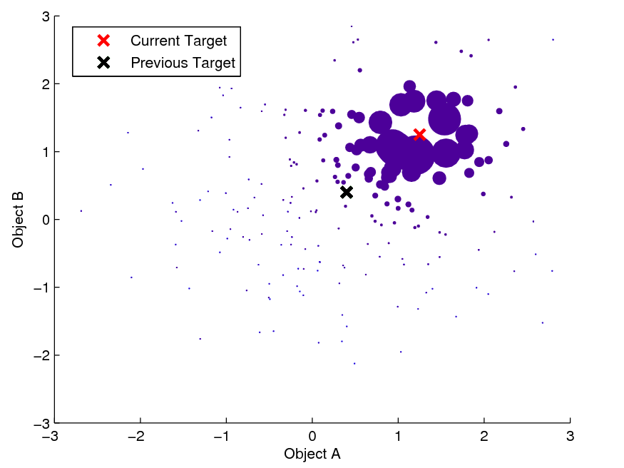
Recursive bayesian filtering
Kalman filter exact solution
Continuous state space
Linear dynamics
Gaussian observation density
Particle filter approximate solution
Continuous, discrete, or mixed state space
Arbitrary dynamics
Arbitrary observation density
Notes:
Two inference methods:
Kalman Filter
@ observation model (likelihood) MUST BE GAUSSIAN
@ single-modal
@ GAUSSIAN POSTERIOR – our belief about the location of the object is modeled as a gaussian
Particle Filter
@ much more versitile
@ but, an approximate solution
@ can be multi-model
@ WEIGHTED SAMPLE POSTERIOR – our belief about the location of the object is modeled as weighted samples

Slide 26
Outline
Introduction to the tracking problem
Recursive Bayesian filtering
What is tracking?
Background & formulation
Kalman filter
Particle filter
Approaches , assumptions, &applications
State of the art & challenges

Slide 27
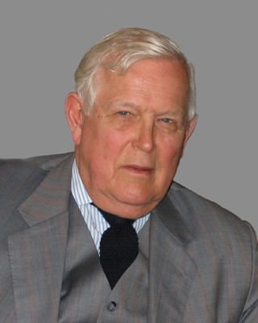
Kalman filter
Published in 1960 Kalman, R. E. 1960. “A New Approach to Linear Filtering and Prediction Problems,” Transaction of the ASME—Journal of Basic Engineering, pp. 35-45 (March 1960).
Used for many problems
Guidance
Navigation
Autopilots
Radar
Satellite
Weather forecasting
Notes:
Rudolf E. Kalman
Published in 1960 in a Mechanical Engineering Journal!
-Used in the NASA Apollo trajectory estimation & navigation computer
-Used in missiles, submarines
-Used in Space Shuttle
-Used in International Space Station (ISS) attitude control & navigation
From a theoretical standpoint, the Kalman filter is an algorithm for efficiently doing exact inference
-in a linear dynamical system, which is a Bayesian model similar to a hidden Markov model
-but where the state space of the latent variables is continuous and
-where all latent and observed variables have a Gaussian distribution
There are also MANY VARIATIONS of the Kalman filter!

Slide 28
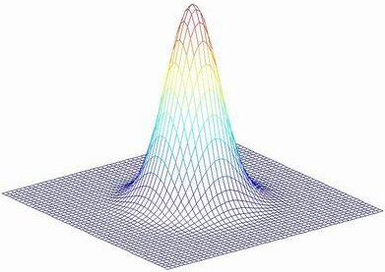
Kalman filter: Gaussians!
in bayesian filtering terms
posterior
motion model
observation model
Notes:
The kalman filter models just about everything from the bayesian filtering distribution as a Gaussian.
Much of what the kalman filter does can be reduced to propagating & updating Gaussians and updating their covariances!
x_t|t – the Gaussian mean representing the state at time t
P_t|t – the Gaussian covariance representing the state at time t
Ft – the state transition model (dynamic model) – transforms x_t-1|t-1 into x_x|t-1
Ht - H maps from the state space to the observation space
Talk about what are some of the terms xt|t, Pt|t, etc

Slide 29
Probability density propagation
Kalman filter uses Gaussians
predict
measure
time t+1
correct
Notes:
(Start)
At t-1 (orange) with a previous estimate of the state modeled by a Gaussian
(predict)
propogate the gaussian according to the motion model and update its covariance (we’re less sure about where it will be than we are of where it was)
(measure)
(yellow) measurements are modeled as Gaussians in the kalman filter (in yellow)
(correct)
use the measurement to correct the prediction , this gives us a new state at time t
(iterate)
this estimate becomes the first step for the next iteration.

Slide 30
Kalman filter
Predict, measure, correct cycle iteratively estimates the state at each time step
predict
measure
correct
Notes:
NOW, let’s look in detail at how the Kalman filter works.
The green line at the top represents an object we’d like to track, with the blue X’s marking the objects true position
describe the familiar cycle. PREDICT, MEASURE, CORRECT

Slide 31
Kalman filter
State vector
Measurement
predict
measure
correct
Notes:
-Describe State vector
Describe measurement
– NOTICE THAT THE MEAUREMENT IS MISSING VELOCITY TERMS – it does not have to match the state vector! EMPHASIZE THAT IT IS A SINGLE MEASUREMENT (GAUSSIAN) – KIND OF LIKE A BLIP ON THE RADAR SCREEN

Slide 32
Kalman filter
Initial state
predict
measure
correct
Notes:
To start we need to have an initial estimate, represented by a Gaussian (orange ellipse)
-The initial estimate has an initial state given by x0|0 – describe components
-The initial estimate also has an Initial covariance – given by P0|0
L is the variance for individual elements of the state

Slide 33
Kalman filter
Prediction from the motion model
Update the mean
predict
measure
correct
Notes:
The PREDICTION STEP modifies the previous state estimate based on the motion model.
Bayesian formulation p(xt|xt-1) -> our prediction should appear as a guassian.
F is the state-transition (dynamic) model (responsible for moving the mean of the gaussian)
x1|0 = F1 x0|0
-Note that we don’t have a COVARIANCE yet!

Slide 34
Kalman filter
Prediction from the motion model
Update covariance
predict
measure
correct
Notes:
Update prediction COVARIANCE
The covariance of our prediction is updated by applying the motion model to the the previous covariance and adding the process noise Q, the process noise – the noise inherent in our motion model
Naturally, the covariance of our prediction is wider than the previous estimate because WE ARE LESS SURE ABOUT IT.

Slide 35
Kalman filter
Prediction from the motion model
predict
measure
correct
Notes:
Look at the STATE-TRANSITION (DYNAMIC) model, F
-It is an NxN matrix -> if the state is Nx1
-It relates the state at the previous time step to the current time step in the absence of noise. Here, a 1st order auto-regressive linear model is used.
-Point out the dependancies of x on x*
-Green Gaussians show a series of linear preditions for increasing time steps.
-Note: as we cast predictions further into the future, the prediction covariance increases!

Slide 36
Kalman filter
Receive a noisy measurement (observation)
Observation model
predict
measure
correct
Notes:
MEASUREMENT STEP!
Now, we receive a noisy measurement z_t in the form of a SINGLE GAUSSIAN. (imagine as if it is coming from a radar blip)
-Measurement appears as the golden ellipse centered at z_t with covariance R
-In this example, Z is only a location, no velocity (missing from the state vector).

Slide 37
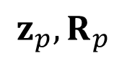
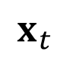
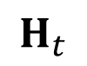
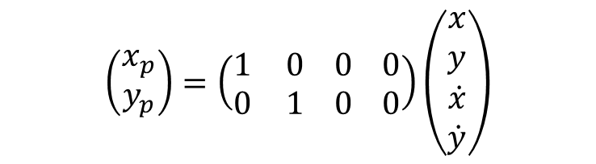
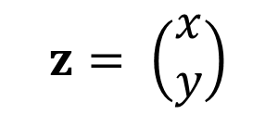
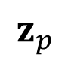
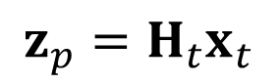
Kalman filter
$$z_{p},R_{p}$$
Predicted observation
$$z= \left(\begin{matrix}x \\ y\end{matrix}\right)$$
predict
$$z_{p}=H_{t}x_{t}$$
$$\left(\begin{matrix}x_{p} \\ y_{p}\end{matrix}\right)=\left(\begin{matrix}1 & 0 \\ 0 & 1\end{matrix} \begin{matrix}0 \\ 0\end{matrix} \begin{matrix}0 \\ 0\end{matrix}\right)\left(\begin{matrix}\begin{matrix}x \\ y\end{matrix} \\ \begin{matrix}\dot{x} \\ \dot{y}\end{matrix}\end{matrix}\right)$$
measure
$$z_{p}$$
$$H_{t}$$
correct
$$x_{t}$$
Notes:
We can also predict where the measurement should occur based on our state prediction.
1.This is done by applying H, which relates the STATE vector to an OBSERVATION vector, to the predicted state x1|0. Note that in this case, it is the exact same place as our prediction x_t (but does not contain a velocity).
-Note the difference between our ACTUAL MEASUREMENT (z1) and our PREDICTED MEASUREMENT (z_p)

Slide 38
Kalman filter
Observation model – how likely is the observation given the prediction?
predict
measure
correct
Notes:
Now, the CORRECTION step.
-Idea: compare the ACTUAL OBSERVATION to our PREDICTION, and update the prediction using this information.
-We are comparing the Green and Yellow gaussians.

Slide 39
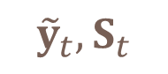
Kalman filter
The residual (innovation),
$${\tilde{y}}_{t}, S_{t}$$
predicted measurement
actual measurement
predict
measure
predicted covariance
correct
measurement noise
Notes:
RESIDUAL, also known as innovation, is modeled by a Gaussian y_t, S_t
RESIDUAL, y_t, measures the DIFFERENCE between what we predicted the measurement to be H_t x_t|t-1 (green gaussian) and the actual measurement z_t (yellow gaussian)
RESIDUAL COVARIANCE , S_t, is a combination of the covariance of the prediction and the measurement noise (our confidence in the observation)

Slide 40
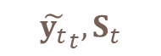

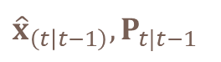
Kalman filter
Correct the prediction using measurement
Kalman gain, – specifies how much the correction considers the prediction or the measurement
$$K$$
${\hat{x}}_{\left(t | t−1\right)},P_{t|t−1}$
$${\tilde{y_{t}}}_{t}, S_{t}$$
predict
measure
predicted covariance
correct
residual covariance
Notes:
CORRECTION STEP!
Kalman gain specifies how much we pay attention to our prediction versus the actual measurement.
-A matrix product of the predicted covariance P_t|t-1, H, and the RESIDUAL COVARIANCE, S_t.
@If we are sure about measurements (z, R):
-Measurement error covariance (R) decreases to zero
-K decreases and
-(next step) weights RESIDUAL more heavily than PREDICTION
@If we are sure about prediction (x, P):
-Prediction error covariance P⁻_{k} decreases to zero
-K increases
-(next step) weights PREDICTION more heavily than RESIDUAL

Slide 41
Kalman filter
Correct the prediction using measurement
predict
state prediction
residual
measure
correct
includes residual covariance
predicted covariance
Notes:
(click) to add the POSTERIOR ESTIMATION (orange ellipse)
(click) to remove MEASUREMENT and PREDICTION
We now CORRECT the prediction using the residual (computed from measurement)
-This results in a corrected state x_t|t, and a corrected state covariance P_t|t
1.Kalman gain controls the trade-off between the prediction from the measurement model and the residual (measurement) in our final estimate of the state
2.Similarly, Kalman gain combines the predicted covariance and the residual covariance.
-note: the CORRECTED covariance is narrower than either measurement or prediction measurement. This follows the intuition that we improve our certainty given more evidence.

Slide 42
Kalman filter
Predict, measure, correct cycle iteratively estimates the state at each time step
predict
measure
correct
Notes:
Now, we iterate to recursively. Our estimate becomes the initial state for the next cycle!
1.Predict the next location
2.Make a measurement
3.Correct the prediction using the Kalman gain (computed from measurement)
4.Feed the corrected estimate as the initial state of the next cycle.

Slide 43

Kalman filter
Kalman filter smoothing of accelerometer measurements.
Notes:
Let’s see the Kalman filter in action!
Here, a Kalman filter is used to estimate the state of an ARTIFICAL HORIZON – which shows the level of an integrated circuit with an ACCELOROMETER. The horizon reflects the tilt of the user’s hand.
-On the RIGHT we see the raw, unfiltered sensor measurements
-On the LEFT we see the Kalman filtered results
Note how the Kalman filter predicts & smooths the data observed from an accelerometer.

Slide 44
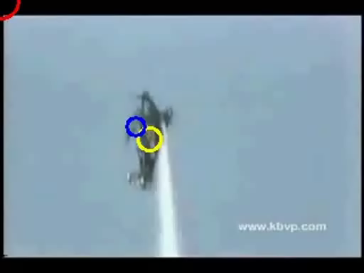
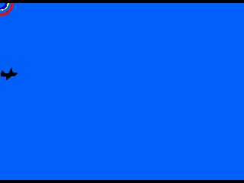
Kalman filter
Kalman filter tracking an aircraft.
Kalman filter tracking an aircraft.
Notes:
Yellow circle is the human-annotated location of the airplane.
Red and blue circles are Kalman filter results (with different measurement noise)
Note how the Kalman filter continues to predict the motion– even when the plane disappears! (this is thanks to the motion model)

Slide 45
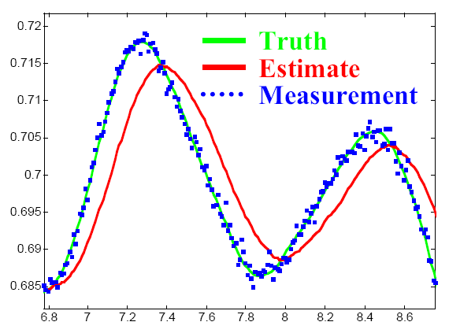
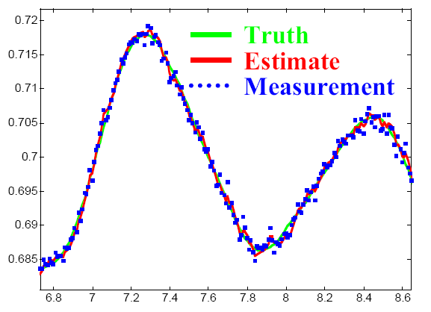
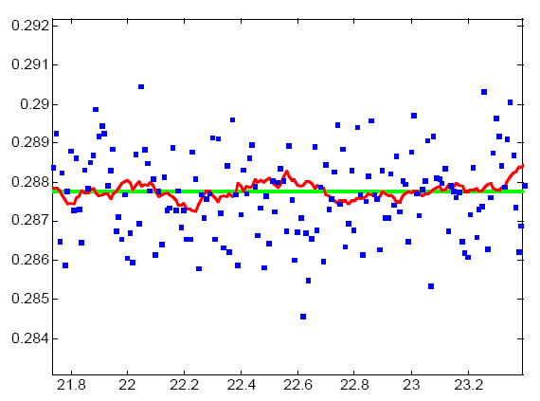
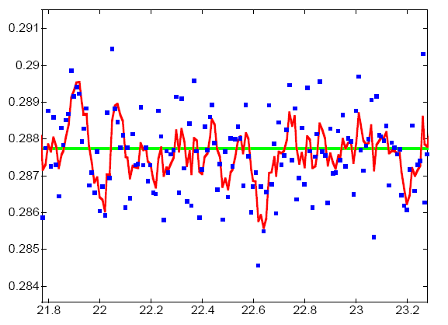
Kalman filter limitations
Position only
Constant velocity model
Notes:
Let’s look at some of the LIMITATIONS of the Kalman filter.
-You need to choose a motion model appropriate for the objects you want to track.
In each plot, the ACTUAL TRACKED OBJECTS TRUE POSITION is in GREEN
-The noisy measurements given to the kalman filter are in BLUE.
-The tracking estimate output of the kalman filter is in RED.
Without velocity (LEFT):
UL: In presence of motion, the Kalman filter lags
LL: KF is more stable
Constant velocity model (RIGHT):
UR: The Kalman filter makes a much better motion estimate (when there is motion)
LR: The KF is much more noisy when there is little (or no) motion!
LESSON: Pick a dynamic model which is appropriate to your object, if you can!

Slide 46
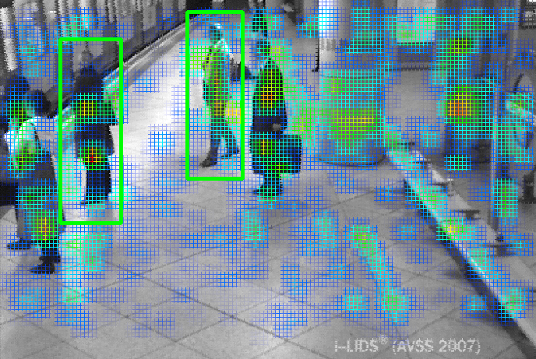
Kalman limitations
No non-Gaussian observation models
M. Breitenstein, F. Reichlin, B. Leibe, E. Koller-Meier, L. Van Gool, Robust Tracking-by-Detection using a Detector Confidence Particle Filter , International Conference on Computer Vision (ICCV), 2009
Notes:
Here is a very nice Non-Gaussian observation likelihood model for pedestrians based on a sliding-window adaboost classifier trained using HOG features.
Unfortunately, the Kalman filter cannot make use of the PDF generated by this observation model
-because it is highly non-Gaussian.

Slide 47
Kalman limitations
Uni-modal distributions fail for unpredicted motion
Prediction too far from actual location to recover
Notes:
Uni-modal distributions (Gaussian) are another limitation.
Toy example: track a ball as it falls and bounces.
The BOUNCE is a NON-LINEARITY we do not anticipate in our motion model. Such things happen ALL THE TIME for various reasons, and can make tracking very difficult.
What happens when we apply the Kalman filter in this example?
(click) – The Gaussian moves down
- The Kalman filter tracks the ball well until it hits the floor.
(click) – but the motion model does do well at prediction the ball’s location after the bounce.
-It may be TOO FAR from the actual location TO RECOVER

Slide 48
Summary: Kalman filter
Pros +
Gaussian densities easy to work with
Exact solution
Well established method
Cons -
Restricted to Gaussian densities
Uni-modal distribution: single hypothesis
Only linear, continuous dynamic model
Notes:
Kalman filter has some serious limiations for practical use:
1.Unimodal
2.Linear Dynamics
3.Limited to Gaussian models – including observation model
So how can we address these limitations?
PARTICLE FILTER! Very POPULAR in tracking applications.

Slide 49
Outline
Introduction to the tracking problem
Recursive Bayesian filtering
What is tracking?
Background & formulation
Kalman filter
Particle filter
Approaches , assumptions, &applications
State of the art & challenges
Notes:
Now, we’ve come to the next section of the talk on PARTICLE FILTERS.
Particle filters are also Recursive Bayesian filtering approaches.

Slide 50
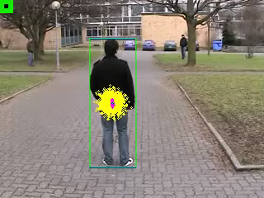
Particle filter
D. Klein, D. Schulz, S. Frintrop, and A. Cremers, Adaptive Real-Time Video Tracking for Arbitrary Objects , International Conference on Intelligent Robots and Systems (IROS), 2010
Notes:
Green box – ground truth (manual)
Blue box – particle filter result
Yellow dot – center of low-rated particle
Purple dot – center of high rated particle
They use Gentle Adaboost to build an adaptive classifier which is used in the observation model
NOTE: the distribution is represented by a set of discrete particles.
NOTE: how the particles can represent a multi-modal distribution!
NOTE: the observation model is highly non-Gaussian!
A standard autoregressive 1st order motion model is used for each particle.

Slide 51

Particle filters
Go by many names:
Sequential Monte Carlo Methods
Sequential importance resampling (SIR)
Bootstrap filters
Condensation trackers
Survival of the fittest
Originally used for problems in
Statistics
Fluid mechanics
Statistical mechanics
Signal processing
Introduced to the Computer Vision community by Michael Isard and Andrew Blake, CONDENSATION -- Conditional Density Propagation for Visual Tracking, International Journal of Computer Vision (IJCV), 29, 1, 5--28, (1998)

Slide 52
Probability density propagation
Gaussian densities → Kalman filter
predict
measure
time t+1
correct
Notes:
We’ve seen this slide before.
Each stage (prediction, measurement, & correction) are modeled as GAUSSIAN DENSITIES in the Kalman filter.

Slide 53
Probability density propagation
General densities → particle filter
predict
measure
time t+1
correct
Notes:
Life would be easier if there was an easy way to model GENERAL DENSITIES!
So the question is:
WHAT APPROACH CAN WE USE TO MODEL ANY OF THE STRANGE PROBABILITY DENSITES that we need IN PRACTICE?S

Slide 54
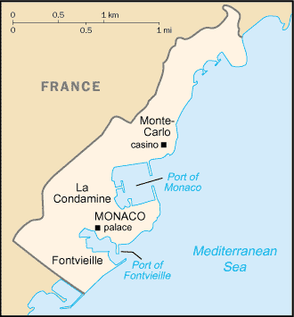
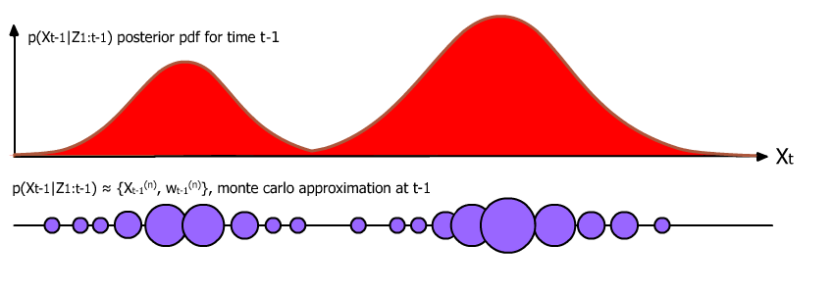
Monte Carlo approximation
How can we represent an arbitrary probability density?
A complicated density we’d like to represent with particles
Monte Caro approximation
Notes:
The answer is: using the MONTE CARLO approximation
The name Monte carlo comes from city on the
French Riviera on the Mediterranean Sea in MONACO,
FAMOUS for gambling!
Let’s say that we have this RED PROBABILITY DENSITY that we’d like to represent.
How does Monte Carlo sampling do this?

Slide 55
Monte Carlo approximation
Represent the density non-parametrically, as a set of (weighted) samples!
Monte Caro approximation
Notes:
Represent the density non-parametrically, as a set of (weighted) samples!
1.Each blue circle represents a sample taken from the distribution.
2.The width of the circles represent their weights.
Graphically, you can see how the a set of weighted particles can approximate a distribution.
-Point out the equation on the bottom.

Slide 56
Particle approximation
Target distribution
Notes:
A simple matlab example of approximating a distribution with particles.
We’d like to represent this mixture of 2 gaussians using particles.
We’ll use the Monte Carlo approximation…

Slide 57
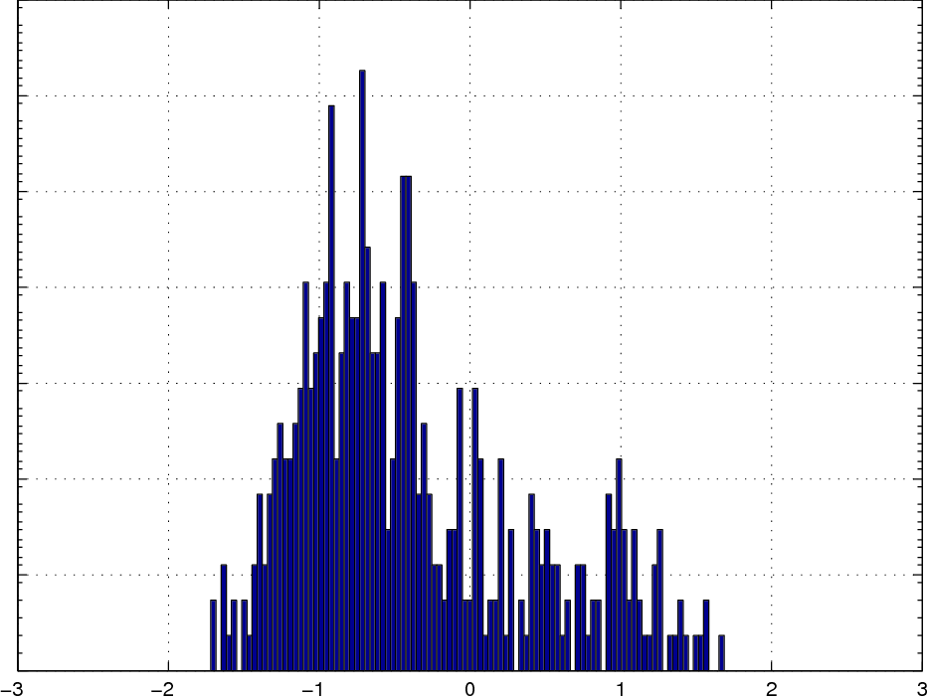
Particle approximation
Monte Carlo approximation – too few samples
Notes:
If we use 250 unweighted samples from the GMM, it does not look like a good representation

Slide 58
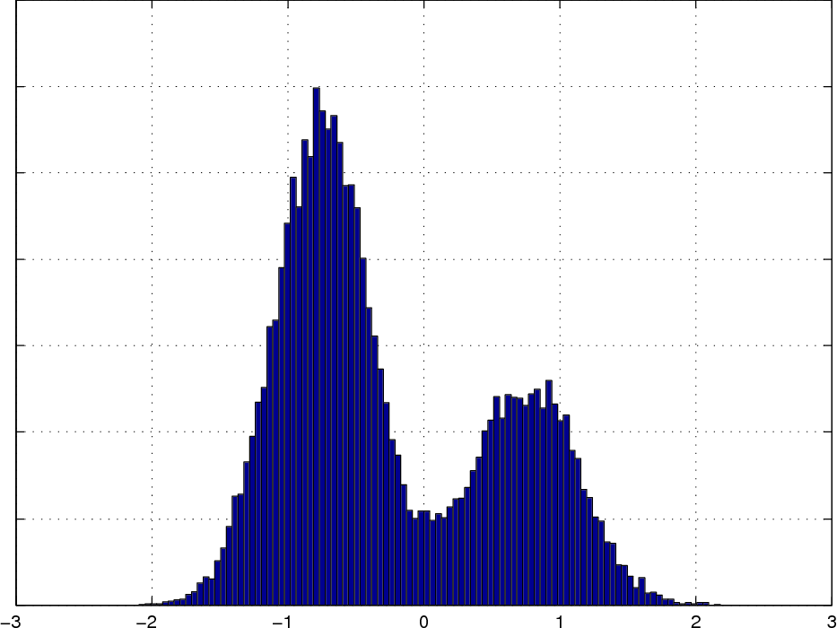
Particle approximation
Monte Carlo approx – added samples
Notes:
But if we take enough samples, we have a good representation of the distribution
Here, I’ve used 2000 samples to represent the distribution.
Note that these samples are UNWEIGHTED. If we give them weights, the representation can be much more efficient!

Slide 59
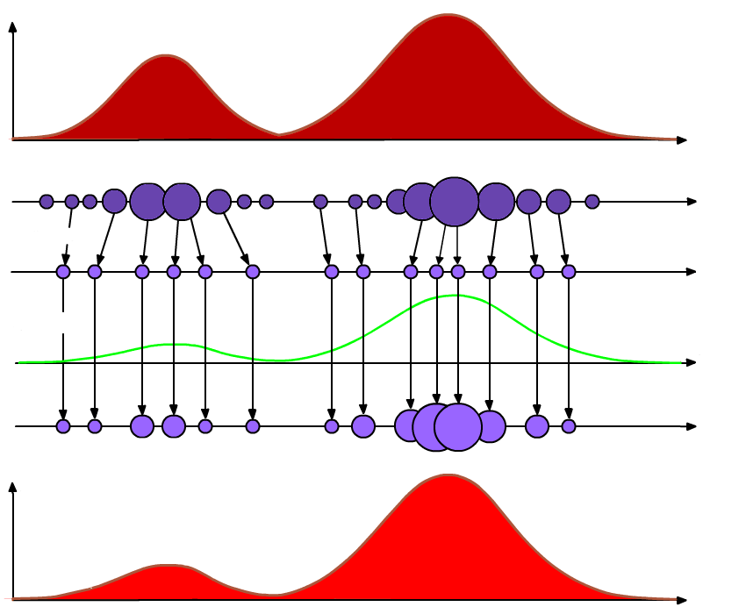
SIR particle filter
time t-1
prediction step
time t
update step
Notes:
OK, so we’ve seen that we can represent a distribution with samples.
We’ve seen with the Kalman filter that it is necessary to propagate and modify the distributions for tracking.
How is this done?
For example, how do we get from the DARK RED density (t-1) on the top to the LIGHT RED density (t) on the bottom?
The answer is the Sequential Importance Resampling (SIR) Particle Filter
@ blue shaded area we have our initial distribution and it’s approximate representaiton from T-1
@ in the red at bottom, we have the distribution we’d like to arrive at TIME T
How do we get there?
Prediction step
Update step

Slide 60
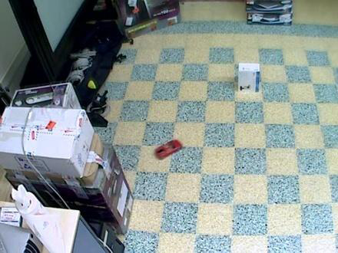
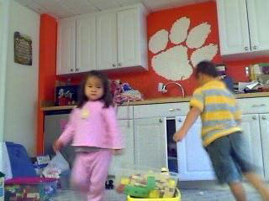
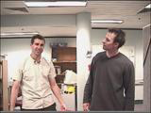
Homework assignment #5
Implement an SIR Particle filter
Code – hand in electronically [7 pts]
Results on 3 sequences
[1 pts]
[1 pts]
[1 pts]
Sequence 1. Toy car
Sequence 2. Girl in Pink
Sequence 3. Head tracking
Notes:
Small – Interruption to discuss the Homework
Homework #5 will be to implement a PARTICLE FILTER.
Total of [10 points]
I will not judge the quality of the tracking – as long as it is reasonable! Don’t spend all day tuning.

Slide 61
Homework assignment #5
Due on December 9th
Skeleton code on course web site
Mundane tasks are already written
Hints provided
Bonus points possible for
Original observation model, or
Automatic initialization
Notes:
Mundane tasks such as
-reading files,
-displaying the images,
-initialization, and
-writing results to file
have been already written for you in the skeleton code.
Hints have also been provided.
Note that you may find it useful to READ THE COMMENTS IN THE SKELETON CODE even if you do not plan on working in Matlab

Slide 62
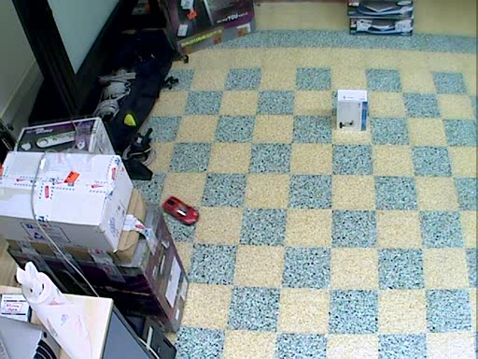
Homework assignment #5
Sequence 1 Track the red toy car
Notes:
See some interesting and difficult problems
Occlusion behind the box.
Some fast dynamics
Moves near the edge of the video

Slide 63
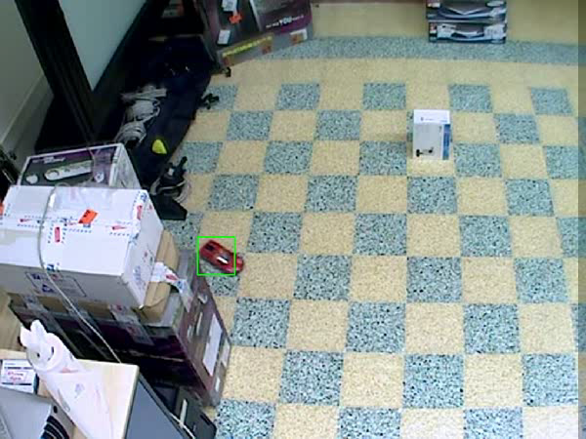
Homework assignment #5
Sequence 1 Red toy car – my results
Notes:
Here are MY RESULTS.
The green bounding box is my posterior estimation of the state in each time frame.
I wrote the code to do this IN A FEW HOURS over the weekend. With the skeleton code, it shouldn’t take you long to get similar tracking results.
Notice how it recovers well from occlusion behind the box, and from being at the edge of the screen.

Slide 64
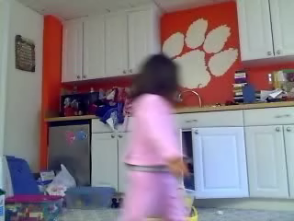
Homework assignment #5
Sequence 2 Track the girl in pink
Notes:
Difficult Motion!

Slide 65
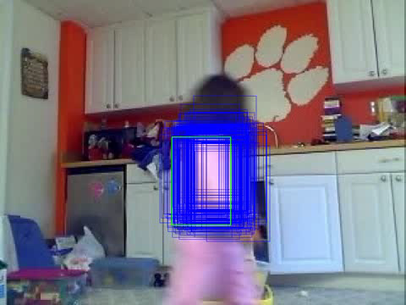
Homework assignment #5
Sequence 2 Girl in pink– my results
Notes:
Difficult Motion!
You can see, my tracker has some difficulty with her speed
Also DRIFT
Note: in your homework, I won’t expect perfect results on every sequence, I just want to be able to see what’s going on!

Slide 66

Homework assignment #5
Sequence 3 Track the head of the person on the left
Notes:
-the COLOR of the BOOKSHELF in the background is very distracting here!
Point out how you can see the multi-modality of the PF on the bookshelf

Slide 67

Homework assignment #5
Sequence 3 Head tracking– my results
Notes:
@ the bookshelf in the background is very distracting here!
Point out how you can see the multi-modality of the PF on the bookshelf
So, now for the rest of the class I will discuss how I implemented the particle filter to get these results!

Slide 68



What is a particle?
A “sample” of the posterior
Particles contain a
state estimate
weight
Summing the particles gives an approximation to the target distribution
$$s_{t}^{n}≜\left(x_{t}^{n},w_{t}^{n} \right)$$
Notes:
What is a PARTICLE? It is also known as a SAMPLE.
This is because it is a sample of the target (posterior) distribution
Each particle contains a
1.STATE ESTIMATE x_t
2. ASSOCIATED WEIGHT w_t
-Particles are indexed by *n* -> a total of N particles
As we saw before, many particles together approximate the posterior
* Walk through the equation (with the diracs and weights)

Slide 69


What is a particle?
Each particle contains a
state estimate
weight
$$s_{t}^{n}≜\left(x_{t}^{n},w_{t}^{n} \right)$$
$$s_{t}^{n}≜$$
Notes:
DECOMPOSE a particle
Here we see the state vector
-For the homework, we will use a bounding box with a velocity component
-walk through the elements of the state vector
(click) Yellow and Purple STATE ESTIMATES (bounding boxes) corresponding to PARTICLES appear
(x,y) corresponds to the upper left corner,
(x*,y*) is velocity of bounding box,
a is aspect ratio (width/height),
h is height
Notice that the weights correspond to how good the estimate is
+high weight indicates a strong estimation
-Low weight indicates poor estimation

Slide 70
SIR particle filter
Begin with weighted samples from t-1
Resample: draw samples according to {w_{t-1}}^{n=1:N}
Drift: apply motion model (no noise)
Diffuse: apply noise to spread particles
Measure: weights are assigned by likelihood response
Finish: density estimate
Notes:
Now let’s take a look at the algorithm for the SIR particle filter.
Here is an overview.
@ read each, give brief description.

Slide 71
Probability density propagation
Notice similarities to the familiar recursive process
predict
measure
time t+1
correct
Notes:
Note how the algorithm corresponds to our familiar iterative cycle
PREDICT
MEASUREMENT
CORRECT
ITERATE

Slide 72


SIR particle filter
Begin with weighted samples from t-1
Resample: draw samples according to {w_{t-1}}^{n=1:N}
$$t−1$$
Drift: apply motion model (no noise)
$$t$$
Diffuse: apply noise to spread particles
Measure: weights are assigned by likelihood response
Finish: density estimate
Notes:
RED: start with the PREVIOUS ESTIMATION, resample and normalize weights
GREEN: make a PREDICTION based on the motion model for each particle
GOLD: make a MEASUREMENT using the observation model
RED: update the particle weights using the OBSERVATION MODEL to give a POSTERIOR ESTIMATION
-Then we iterate

Slide 73
SIR particle filter
Begin with weighted samples from t-1
$$t−1$$
$$t$$
Notes:
Now, we will go through each step in detail.
Start with the weighted samples from the previous time step which represent the PREVIOUS POSTERIOR distribution.
Point out sample representations, equations

Slide 74

Previous estimate
Receive posterior estimate from previous time step
$${\left\{x_{t−1}^{n}, w_{t−1}^{n}\right\}}_{n=1}^{N}$$
Notes:
Particles here represent the posterior of previous time step.

Slide 75
SIR particle filter
Resample: draw samples according to {w_{t-1}}^{n=1:N}
N new samples are drawn from the previous set with replacement.
New samples are assigned uniform weights.
$$t−1$$
$$t$$
Notes:
Notice they are in the same location as before.
New uniform weights.
Repeated samples.
This is another way of representing the same distribution (without weights)

Slide 76
Resample
N new samples are drawn from the previous set with replacement to prevent degeneracy.
Repeated samples occur by design.
Weighted
sampling with
replacement
New sample set
is given uniform
weights
Notes:
(click) to next slide to show the resampling step
Resampling draws new samples from the previous particle set.

Slide 77
Resample
N new samples are drawn from the previous set with replacement to prevent degeneracy.
Repeated samples occur by design.
Weighted
sampling with
replacement
New sample set
is given uniform
weights
Notes:
Degeneracy is when a single sample has an extremely dominant weight.
Repeated samples occur by design.
Every time you take out the bucket, you MUST PUT IT BACK.

Slide 78

Degeneracy
Failing to resample results in degeneracy.
Iteratively propagating the particles and assigning weights tends to make a few samples dominate the rest
t
Distribution no longer representative
Notes:
-Blue dots represent the samples
-Red lines represent the distribution they approximate
Over time, if we keep weighting the particles according to how good they are, weights will accumulate
1.good particles will get more & more weight,
2.bad particles will get less & less weight.
Distribution is no longer well represented!

Slide 79
SIR particle filter: predict
Apply the motion model p(x_{t}|x_{t-1}) to every particle!
Drift: apply motion model (no noise)
$$t−1$$
$$t$$
linear motion
model
noise
Diffuse: apply noise to spread particles
Notes:
APPLY THE MOTION MODEL
Broken into 2 steps for ease of understanding.
First, DRIFT. We apply the linear dynamics to each particle and predict a new location for them.
-Note that since each non-repeated particle has a different state estimate, predictions will be different!
-point at F in equation
Next, we apply the noise term w_t, sampled from a zero-mean gaussian to perform DIFFUSION.
-This randomness and spreading of the particles is what makes the PF robust,
-it covers even some UNLIKELY hypotheses.

Slide 80


Motion model
Apply the motion model p(x_{t}|x_{t-1}) to every particle!
linear motion
model
noise
$$w_{t}\sim N\left(0,Q_{t}\right)$$
Notes:
Here you see our particle approximation for time t-1
(click) Advance to next time step!
Motion model is applied to each particle is individually
It has 2 components:
(click) the linear dynamic prediction term (DRIFT)
(click) the gaussian noise DIFFUSTION sampled from a zero-mean gaussian with covariance Q
(click) and now to see the rest of the particles

Slide 81
SIR particle filter: measure
Obtain an observation z_{t} for each state estimate x_{t.}
Evaluate likelihood that x_{t} gave rise to z_{t} using observation model.
$$t−1$$
$$t$$
Measure: weights are proportional to the observation likelihood
Notes:
Evaluate the observation model according to the state estimate of each particle.
Read the text
Observation model:
-Models the likelihood that we the observed measurement z_t would appear given the state of the object x_t
Point out the two important distributions! P(zt|xt) and p(xt|Zt)

Slide 82
Observation model
Obtain observation z_{t} for each state estimate x_{t.}
Notes:
Here, we have a bunch of state estimates propagated by the motion model xt.
Now, we need to turn these state estimates into observations using data from the image.

Slide 83


Observation model
Obtain observation z_{t} for each state estimate x_{t.}
Notes:
In this case, we will use image data from within the bounding box defined by the state estimate to form our observation.
Note that this is not always how it is done.
Let’s look at 2 state estimates,
1.Defined by the BLUE bounding box
2.Defined by the ORANGE bounding box
Note that the BLUE one is a much better guess as to where the pink girl is.

Slide 84





Observation model
Obtain observation z_{t} for each state estimate x_{t.}
$$z_{t}^{1}$$
LAB color histogram
LAB space
LAB color histogram
Observations are obtained by converting pixel values within bounding boxes to LAB color space, and concatenating to form an AB channel histogram
$$z_{t}^{2}$$
Notes:
My observation model does the following.
1.Extract pixels from within the bounding box
2.Convert the pixel data from RGB color space to LAB
-LAB is more invariant to lighting changes
-On left you can see the A&B space for various L values
3.Using the A & B channels, construct a histogram of the pixel data
-Concatenate the histograms into a single color descriptor vector.
4.This HISTOGRAM is our observation z_t. It is a measurement from the data extracted according to x_t

Slide 85


Observation model
Obtain observation z_{t} for each state estimate x_{t.}
Evaluate likelihood that an x_{t} gave rise to z_{t} using observation model.
$$z_{t}^{1}$$
$$p\left(z_{t} | x_{t}^{n}\right)=e^{−λ dist\left(z_{t},c\right)}$$
known
color model
$$z_{t}^{2}$$
Observation model compares z_{t} to a known color model c using the KL divergence.
Notes:
The OBSERVATION MODEL tells us how likely it is that we should see these particular observed histograms.
It will compare the observations we’ve just extracted to a KNOWN COLOR MODEL
-using an exponential comparison of the distance between observed histogram and known color model
-KL divergence provides a way of measuring similarity between histograms
-We can obtain the KNOWN COLOR MODEL in a variety of ways. One is to construct it from the intitial frame.

Slide 86
Observation model
Obtain observation z_{t} for each state estimate x_{t.}
Evaluate likelihood that an x_{t} gave rise to z_{t} using observation model.
$$z_{t}^{1}$$
poor match
good match
$$p\left(z_{t} | x_{t}^{n}\right)=e^{−λ dist\left(z_{t},c\right)}$$
known
color model
$$z_{t}^{2}$$
Observation model compares z_{t} to a known color model c using the KL divergence.
Notes:
The OBSERVATION MODEL for each particle P(zt|xt)
+will return a high value if we expected to see such a histogram
-Will return a low value if the histogram did not match the expected model
-Visually, you can see that the BLUE observation is much closer to the known color model

Slide 87
Observation model
Obtain observation z_{t} for each state estimate x_{t.}
Evaluate likelihood that an x_{t} gave rise to z_{t} using observation model.
Assign weights are proportional to the likelihood response
poor match
good match
Notes:
Now, we assign these values from the observation model to the particle weights.
Thus, we reward a good estimate with a high weight.
We penalize a bad estimate with a poor weight.

Slide 88
Observation model
Obtain observation z_{t} for each state estimate x_{t.}
Evaluate likelihood that an x_{t} gave rise to z_{t} using observation model.
Assign weights are proportional to the likelihood response
Notes:
Applying the observation model to each of the particles, we now have an updated distribution!
Notice high weight particles are centered well on the girl, while lower weight particles are on the periphery.

Slide 89
SIR particle filter
Begin with weighted samples from t-1
Resample: draw samples according to {w_{t-1}}^{n=1:N}
$$t−1$$
Drift: apply motion model (no noise)
$$t$$
Diffuse: apply noise to spread particles
Measure: weights are assigned by likelihood response
Finish: density estimate
Notes:
Now, the newly weighted particle set represents our new posterior distribution,
Which in turn represents out belief about the state of the object we want to track.

Slide 90
Obtaining a solution
So far, we do not have an explicit state estimate, we have a cloud of particles!
How do we extract an answer? It depends…
Compute a mean or median particle
Confidence: inverse variance
For discrete labels, this does not work!
Use the mode?
Notes:
You could take maximum likelihood, but this is noisy, and defeats the purpose of the particle filter
Confidence of your estimate
For discrete labels -> for example if one element of your state is used to label 3 people {1,2,3}, you don’t want the mean

Slide 91

Particle filter
original
standard observation model
adaptive observation model
per-particle adaptive model
D. Klein, D. Schulz, S. Frintrop, and A. Cremers, Adaptive Real-Time Video Tracking for Arbitrary Objects , International Conference on Intelligent Robots and Systems (IROS), 2010

Slide 92

Particle filter
original
standard observation model
adaptive observation model
per-particle adaptive model
D. Klein, D. Schulz, S. Frintrop, and A. Cremers, Adaptive Real-Time Video Tracking for Arbitrary Objects , International Conference on Intelligent Robots and Systems (IROS), 2010

Slide 93
Summary: particle filters
Represents arbitrary (multi-modal) densities
Converges to true posterior for nonlinear, non-Gaussian systems
Efficient: concentrates particles on interesting regions
Works for many types of state spaces

Slide 94

Summary: particle filters
Number of samples N is important
Use as few as necessary (for efficiency)
But use enough to do a good job exploring the state space
Complexity grows exponentially with dimensionality of the state space
Notes:
3 objects, C=3 possible states
-as parallel trackers, cost is 3C = 9
-as a joint tracker, cost is C^3 = 27

Slide 95
Things to think about…
Initialization
By hand
Background subtraction
Detection
Observation models
Generative -> render the state on top of the image and compare
Discriminative -> classifier or detector score
Prediction vs Correction
If dynamics dominate, cues form the data may be ignored
If observation model dominates, tracking is not smooth
Nonlinear Dynamics
Needed for multiple objects, discrete state elements, etc.

Slide 96

Particle filters in action
Michael Isard and Andrew Blake CONDENSATION -- conditional density propagation for visual tracking
International Journal of Computer Vision (IJCV), 29, 1, 5--28, (1998)

Slide 97

Particle filters in action
Homework #5, sequence 1
Notes:
My results from our homework
Sequence 1
Toy car

Slide 98
Particle filters in action
tracking a ball
Particle filter recovers
1. multi-modal 2. random sampling
Notes:
Remember this example? The kalman filter couldn’t handle it!
BECAUSE
Nonlinearity in the motion for some reason – like the ball hitting the wall
@ UNIMODAL – must represent the belief about ball location as a single gaussian
@ DYNAMICS – linear dynamics fail us in this case
But, the particle filter can!

